Slide 1
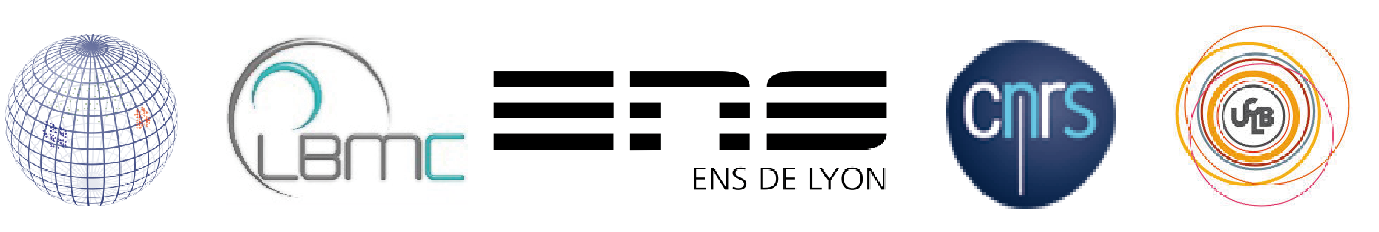

A glimpse on cell decision making through GRN inference
Olivier Gandrillon
November 2023

Slide 2
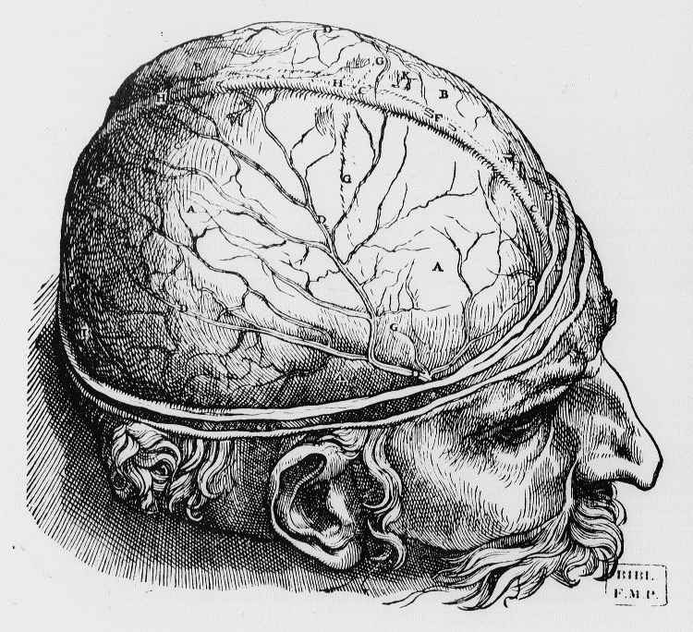
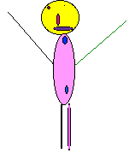
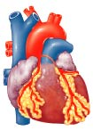
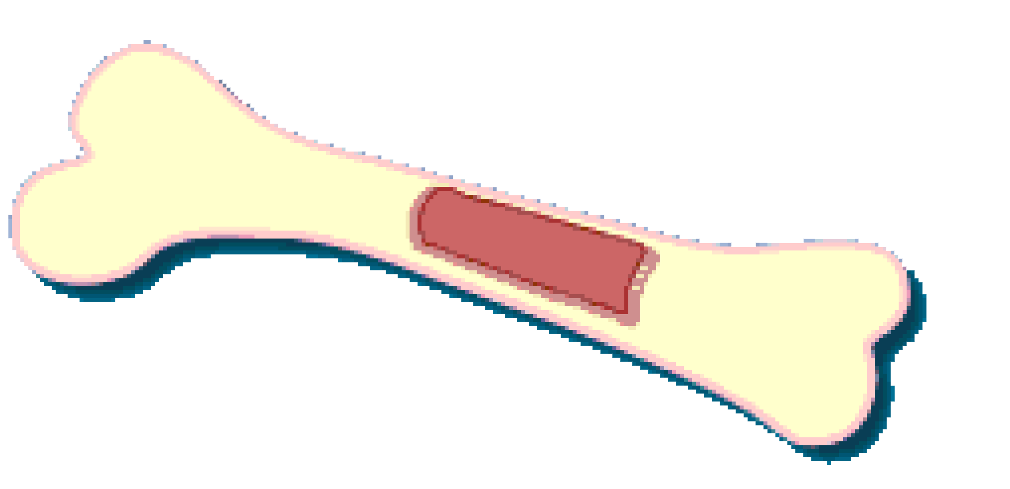
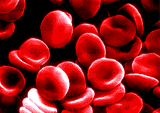
Brain
Heart
Bone
Blood
Organism
Other…
Tissues

Slide 3

Bone-making cells (ostéoblasts)
Bone-resorbing cells
(ostéoclasts)
Bone marrow
Tissues
Cells

Slide 4
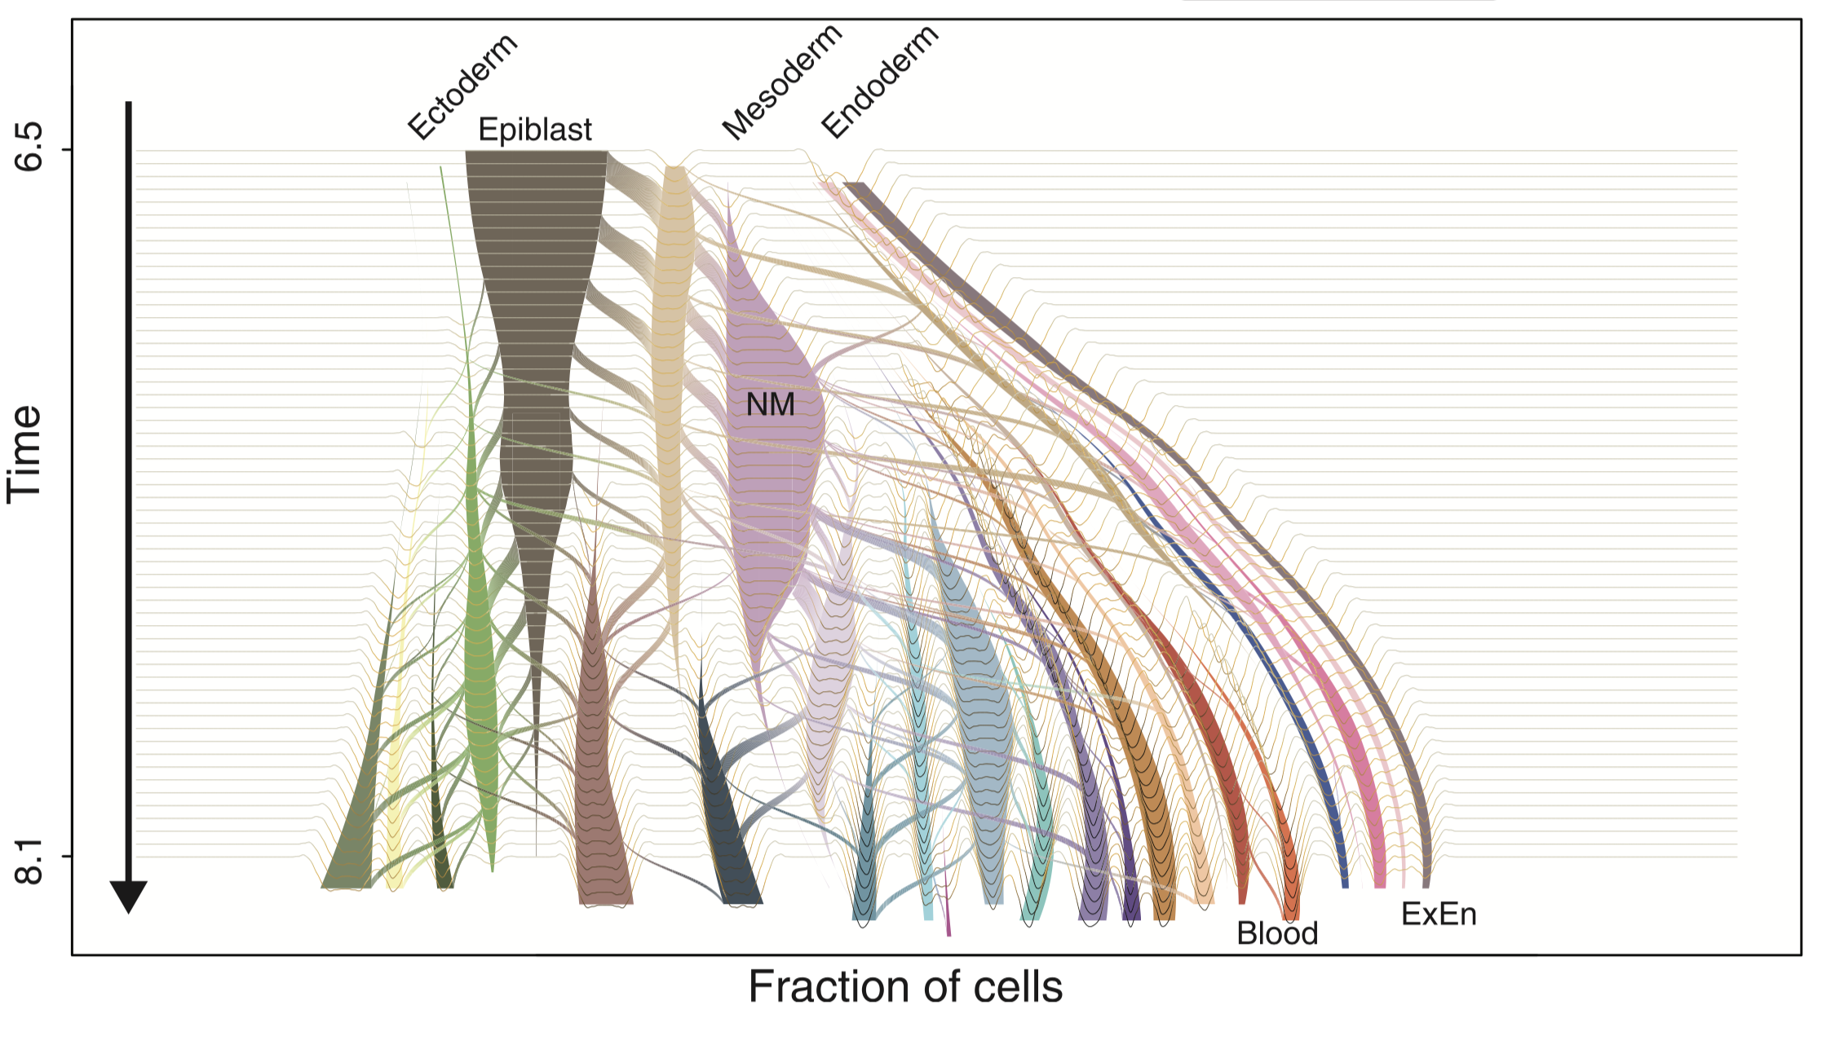
Cells have to make decisions at all steps in the way
Mittnenzweig et al., 2021, Cell 184, 1–18

Slide 5
Let’s take a dynamical systems view on decision making in metazoans

Slide 6
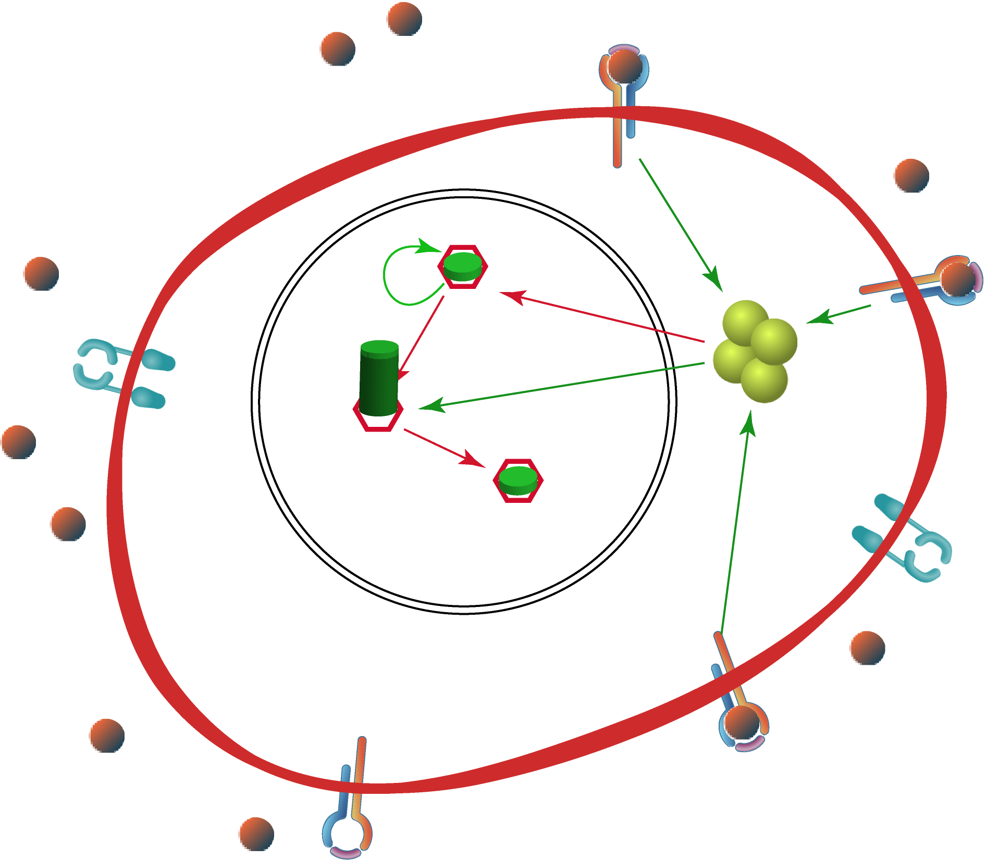
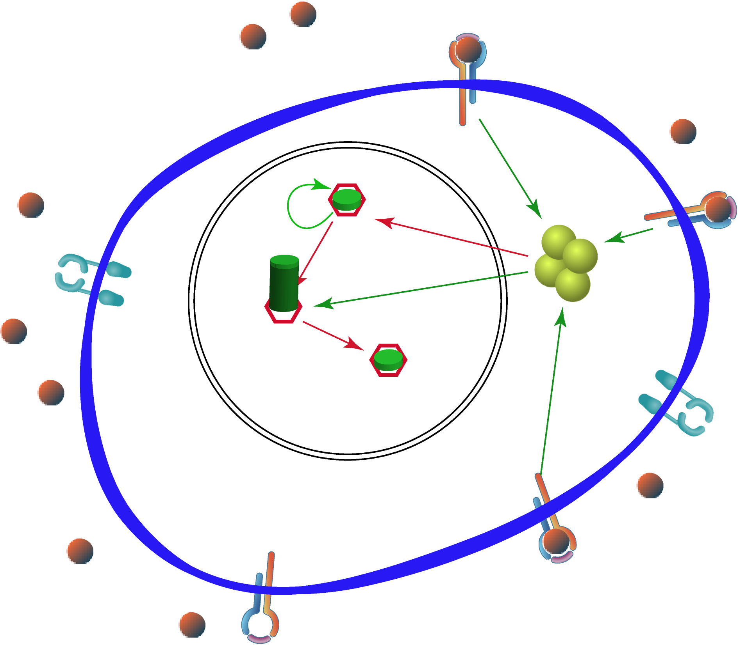
Let’s imagine a cell in a given medium. It reaches an equilibrium, with so-called micro-heterogeneity (due to the probabilistic nature of molecular reactions).

Slide 7
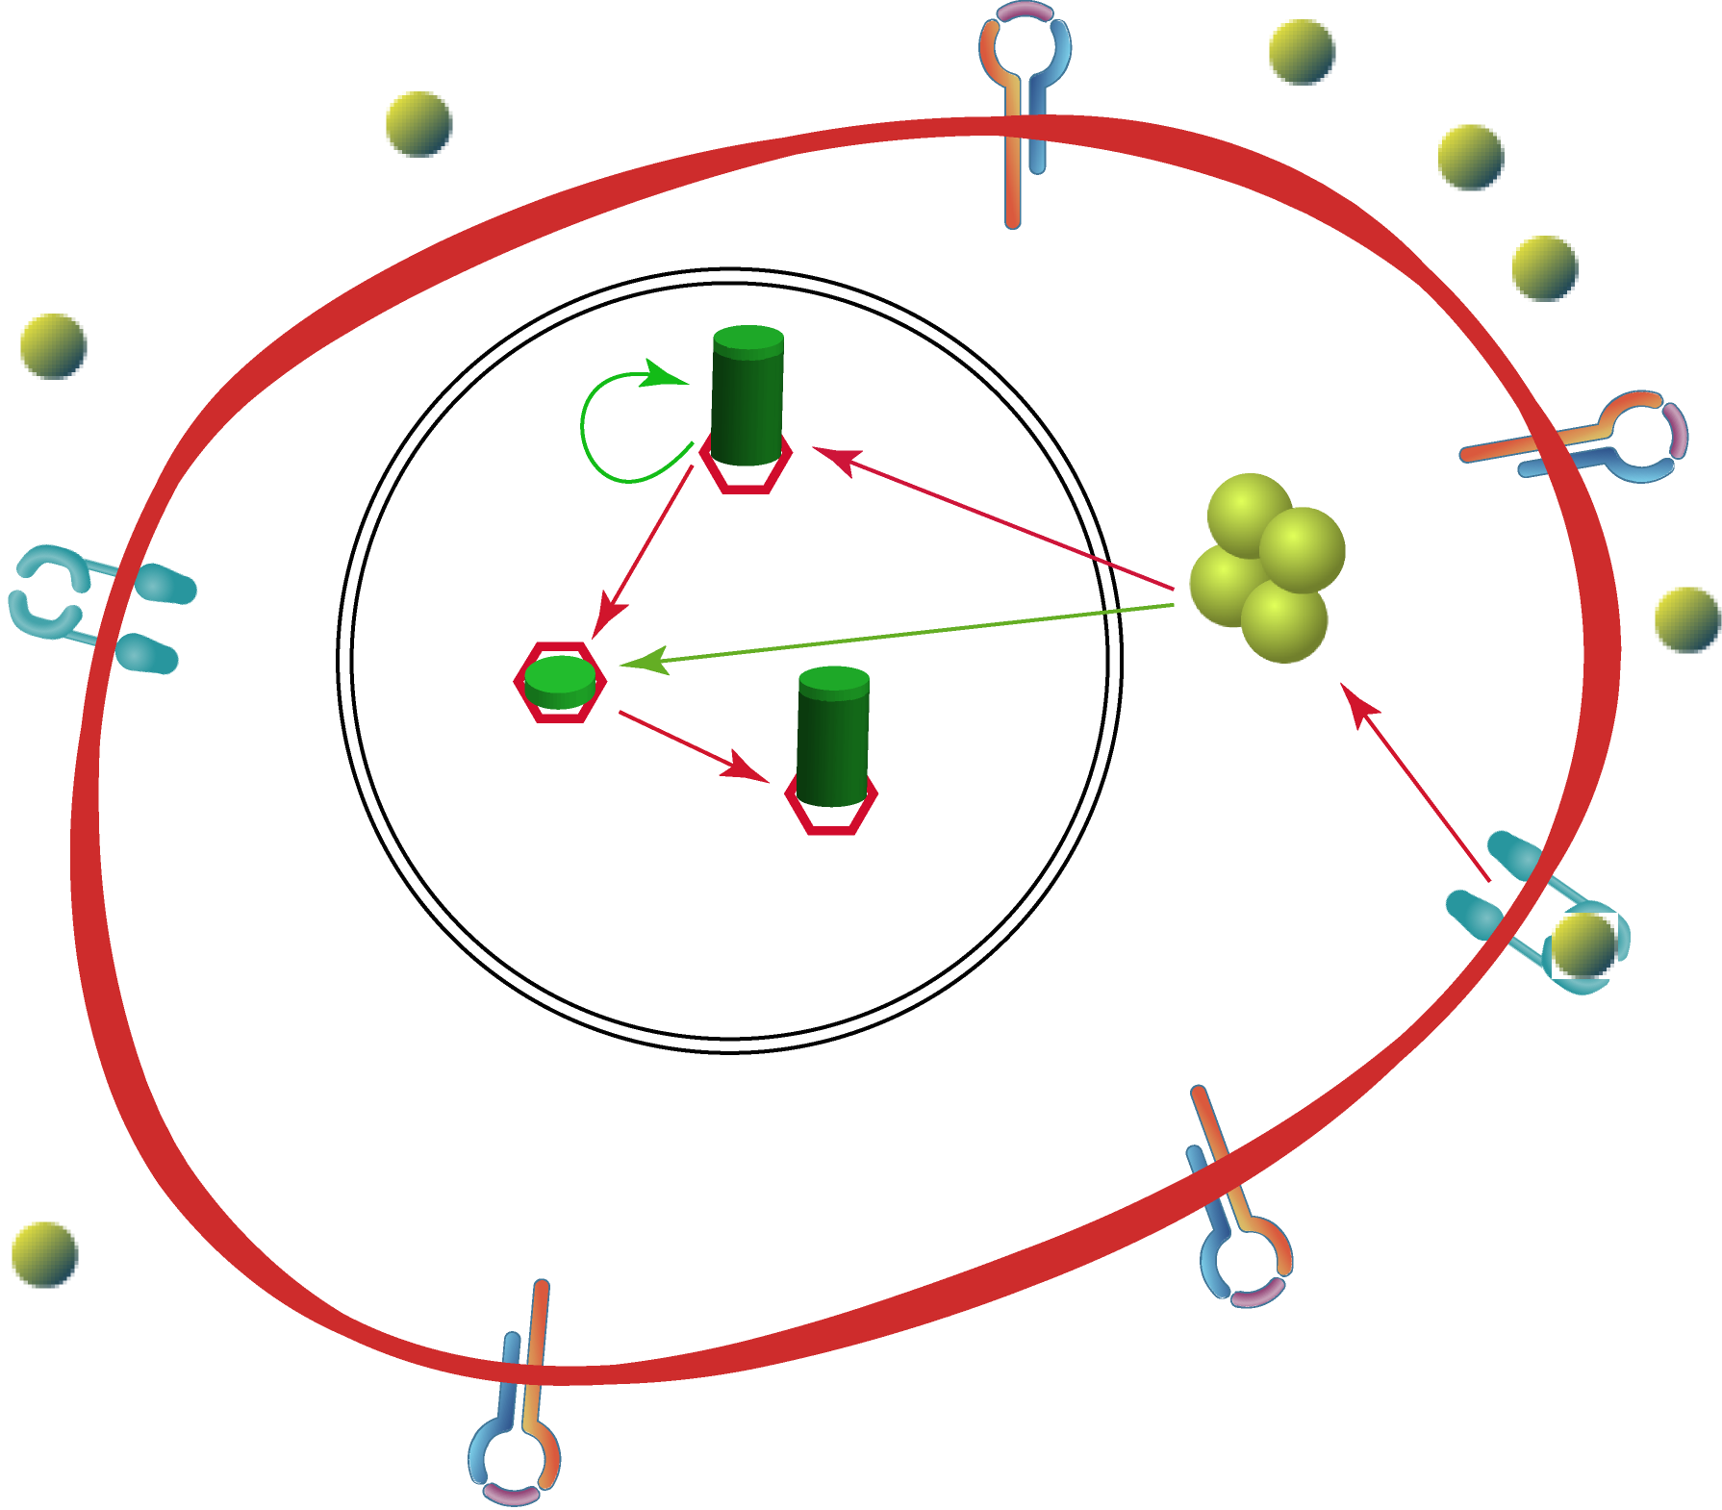
If one changes the external conditions, the internal dynamical system will have to adjust and eventually attain a new stable state. The decision has been made. The transient behavior is a very rich source for dynamical information

Slide 8
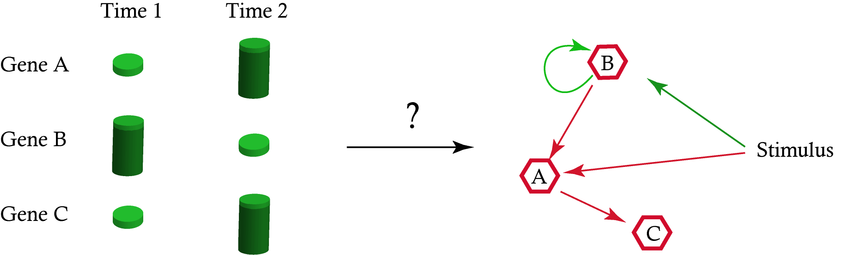
The inference problem (a question that systems biology addresses since its very beginning…):

Slide 9
Our proposal: see the inference of a GRN as a mechanistic model calibration problem.
So, how should we model gene expression at the single cell level?

Slide 10

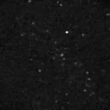
At the single cell level, we will be confronted to the « burstiness » of the gene expression process.
Luciferase
Suter et al. (2011). Science 332, pp. 472-474
Notes:
2972

Slide 11
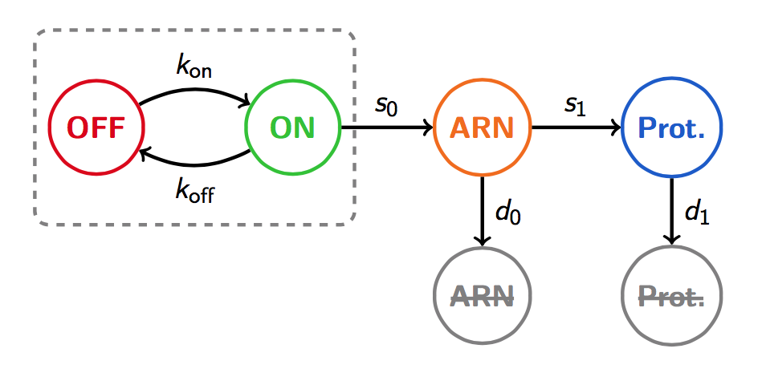
The 2-state model

Slide 12
Describe genes as PDMP
k_{on}
k_{off}
E(t):
Probabilistic part
Deterministic part
0 1 ;
0 1
M’(t) = s₀E(t) – d₀M(t)
P’(t) = s₁M(t) – d₁P(t)

Slide 13
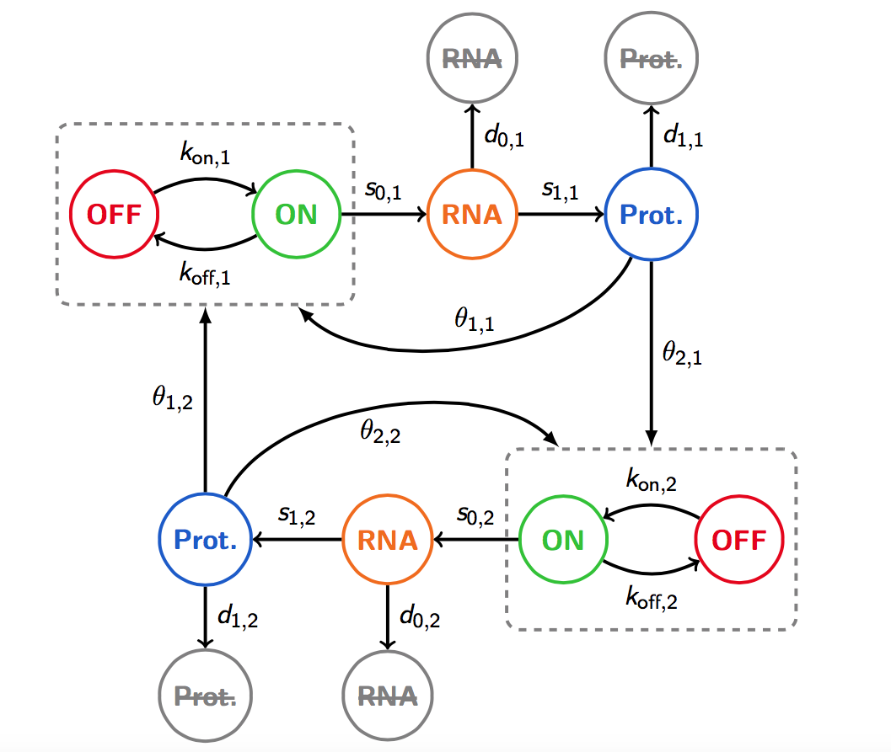
Describe GRNs as coupled PDMP
Herbach, U., et al. (2017). BMC Systems Biology 11:105 .

Slide 14
So now we have an executable model

Slide 15
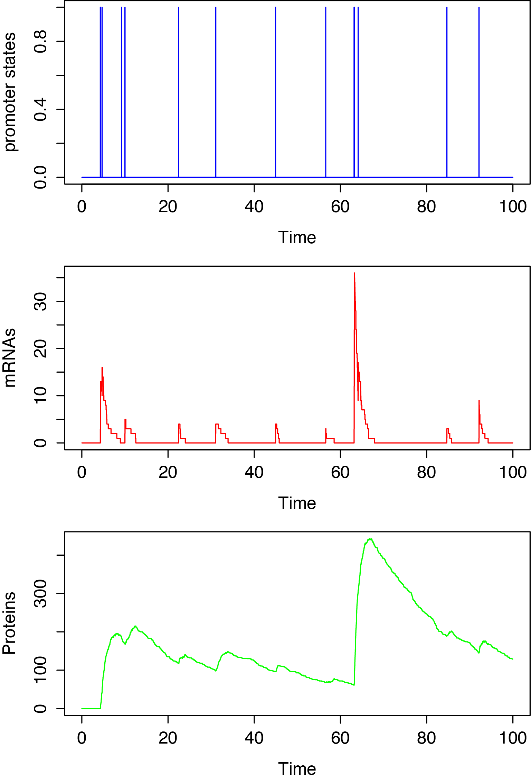
A trajectory of the model

Slide 16
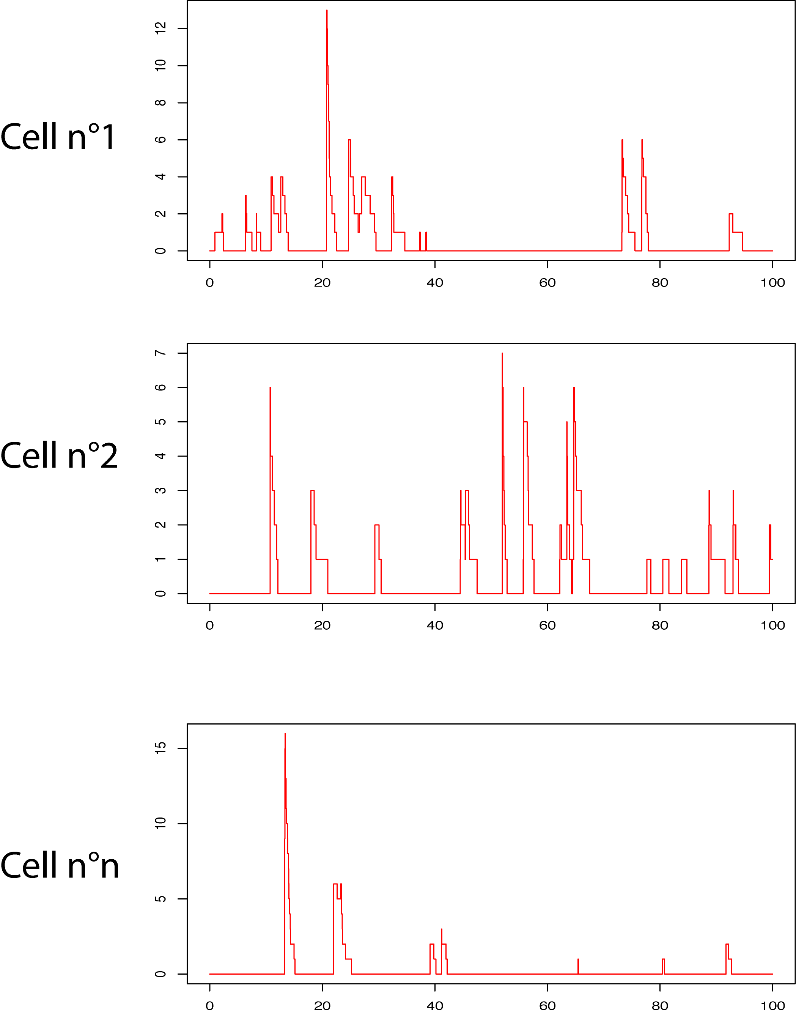
From model simulations
Notes:
3007

Slide 17
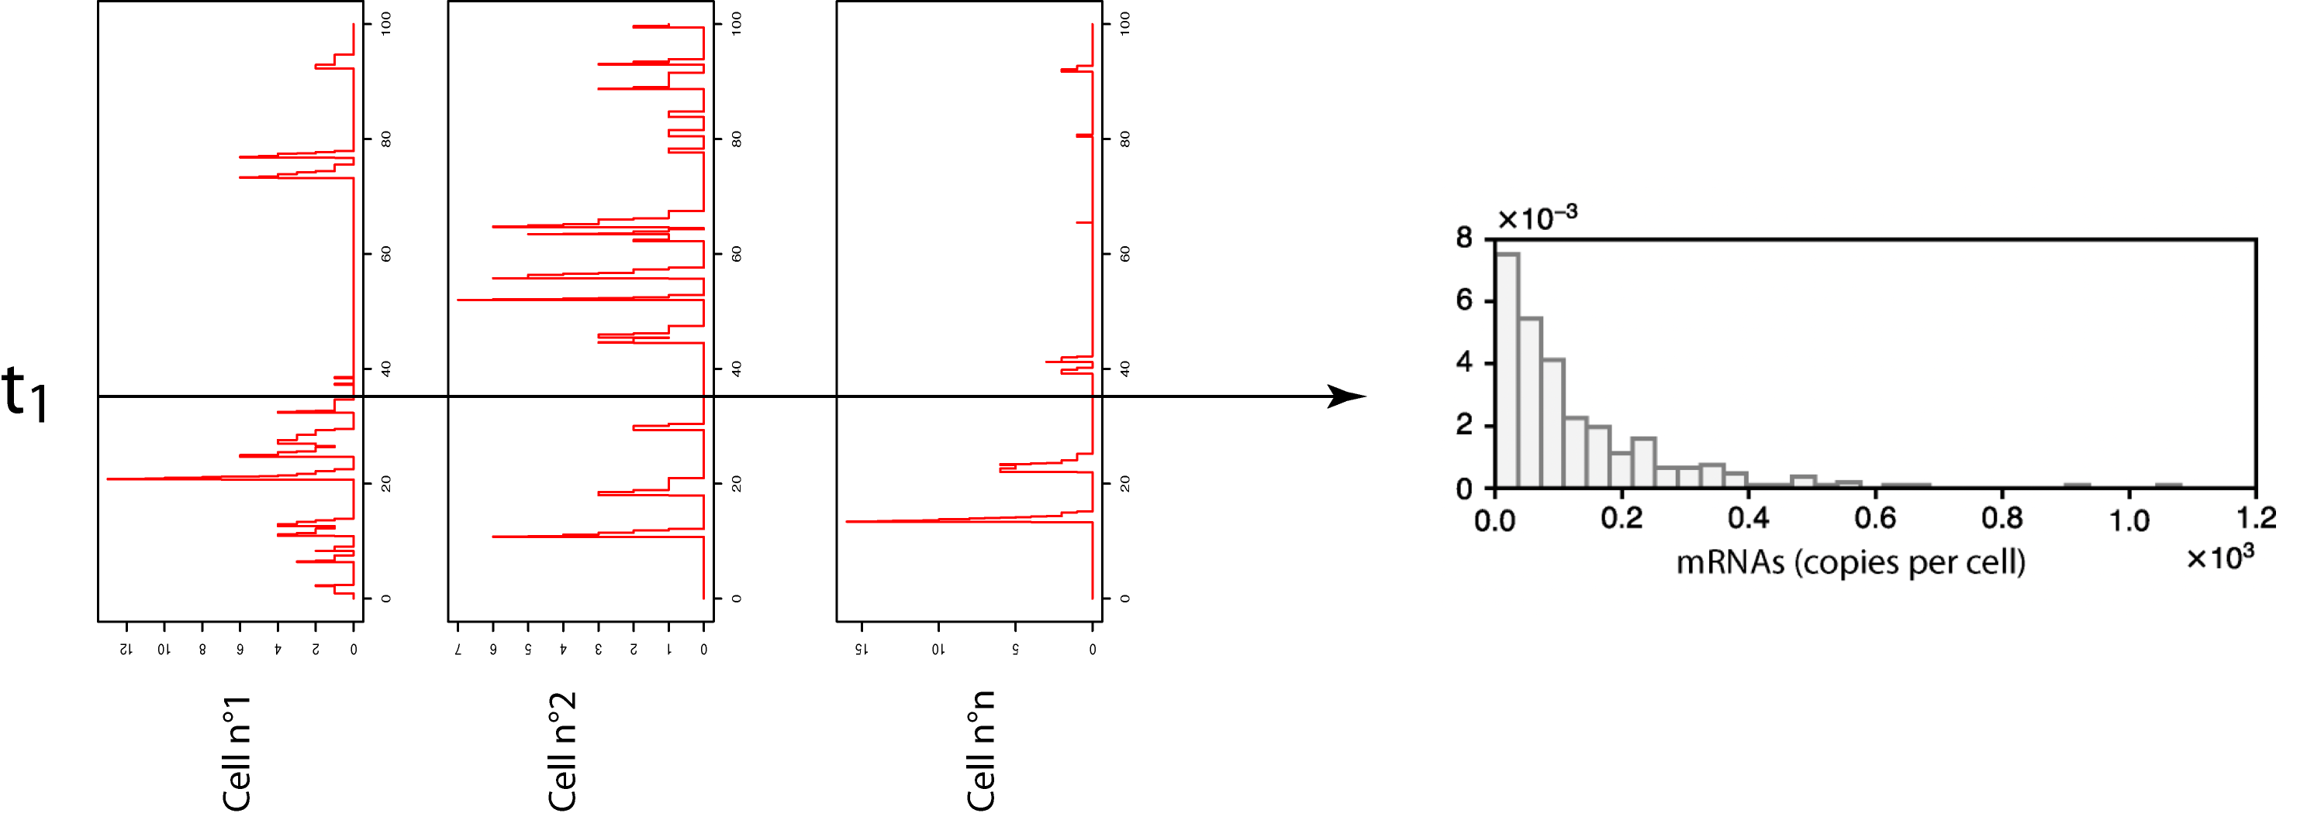
To model-generated distributions
Notes:
3007

Slide 18
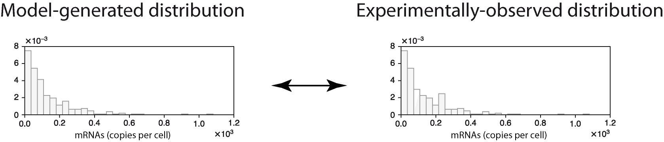
To comparing distributions using Kantorovich distances
The closer the distance, the better the model
Notes:
3007

Slide 19
Inferring a GRN = finding proper model parameter values for reproducing experimental data
Our first proposal: WASABI
(Bonnaffoux, A, et al. (2019). BMC Bioinformatics 20:220)
Our second proposal: HARISSA
(Herbach. U. (2023) Computational Methods in Systems Biology, Lecture Notes in Computer Science.)
Our latest proposal: CARDAMOM
(Ventre*, E., Herbach*, U., et al. (2023). PLoS Comput Biol 19(3): e1010962)

Slide 20
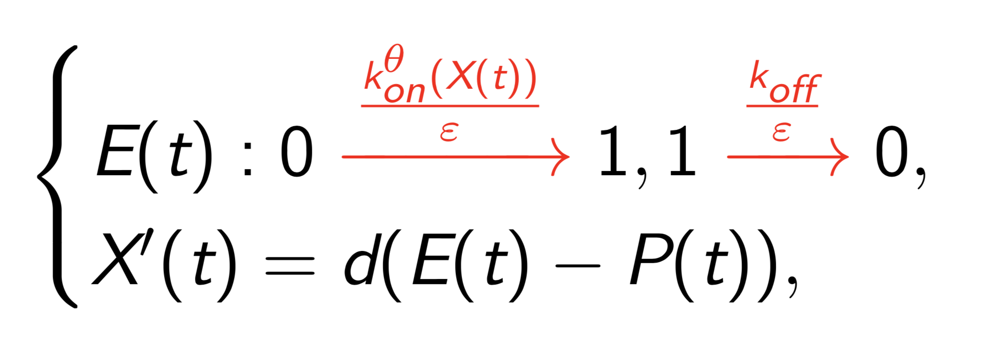
CARDAMOM:
First one simplifies the model by concatenating the transcription and translation steps
Then we assume a time scale separation: promoters are fast in front of proteins
The resulting model reads

Slide 21
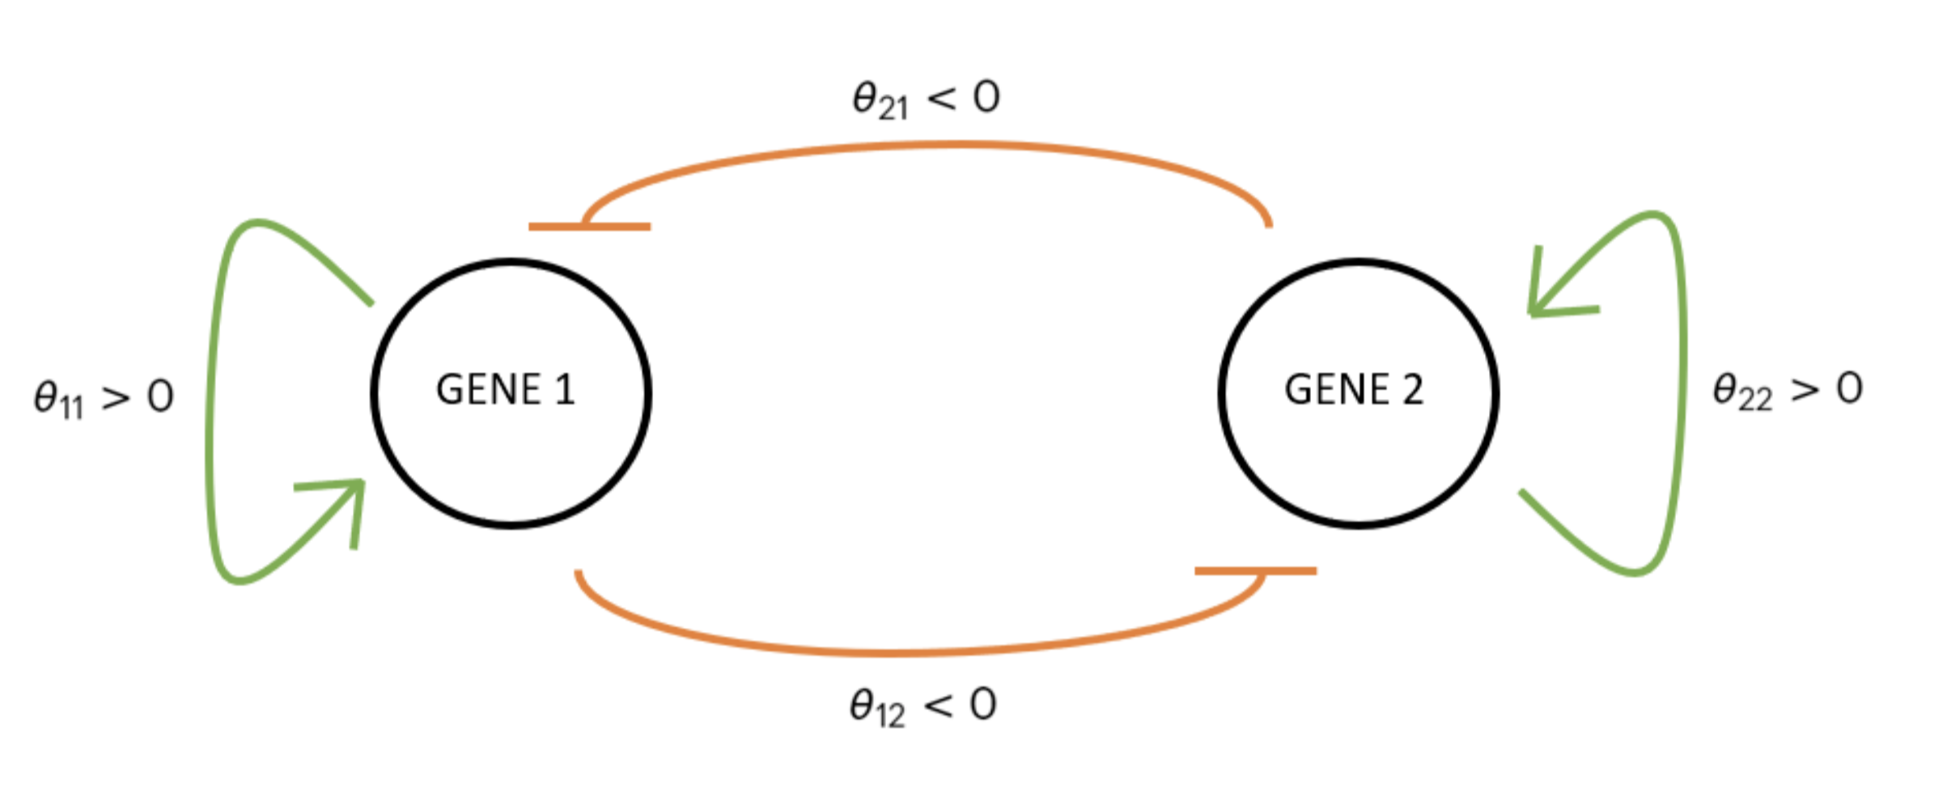
To illustrate, let’s take a simple dynamical system as an GRN example: the toggle switch

Slide 22
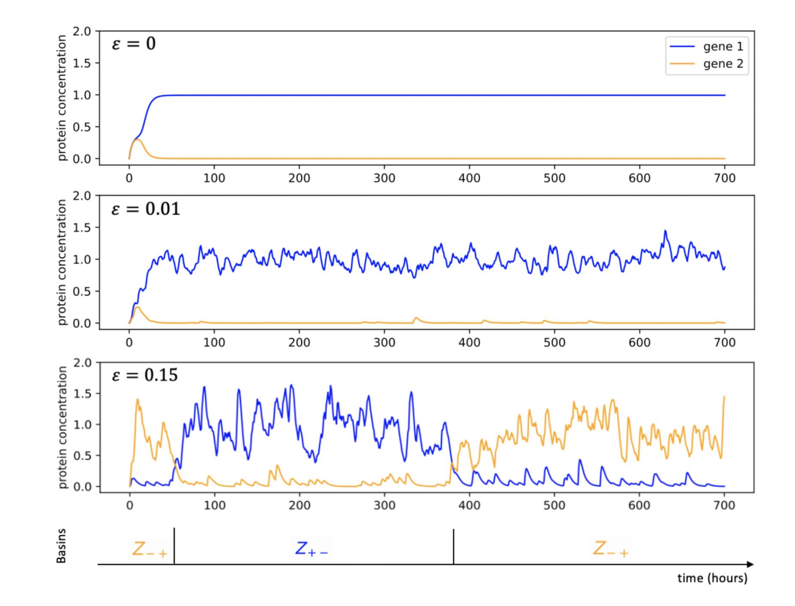
Basins: cell types

Slide 23
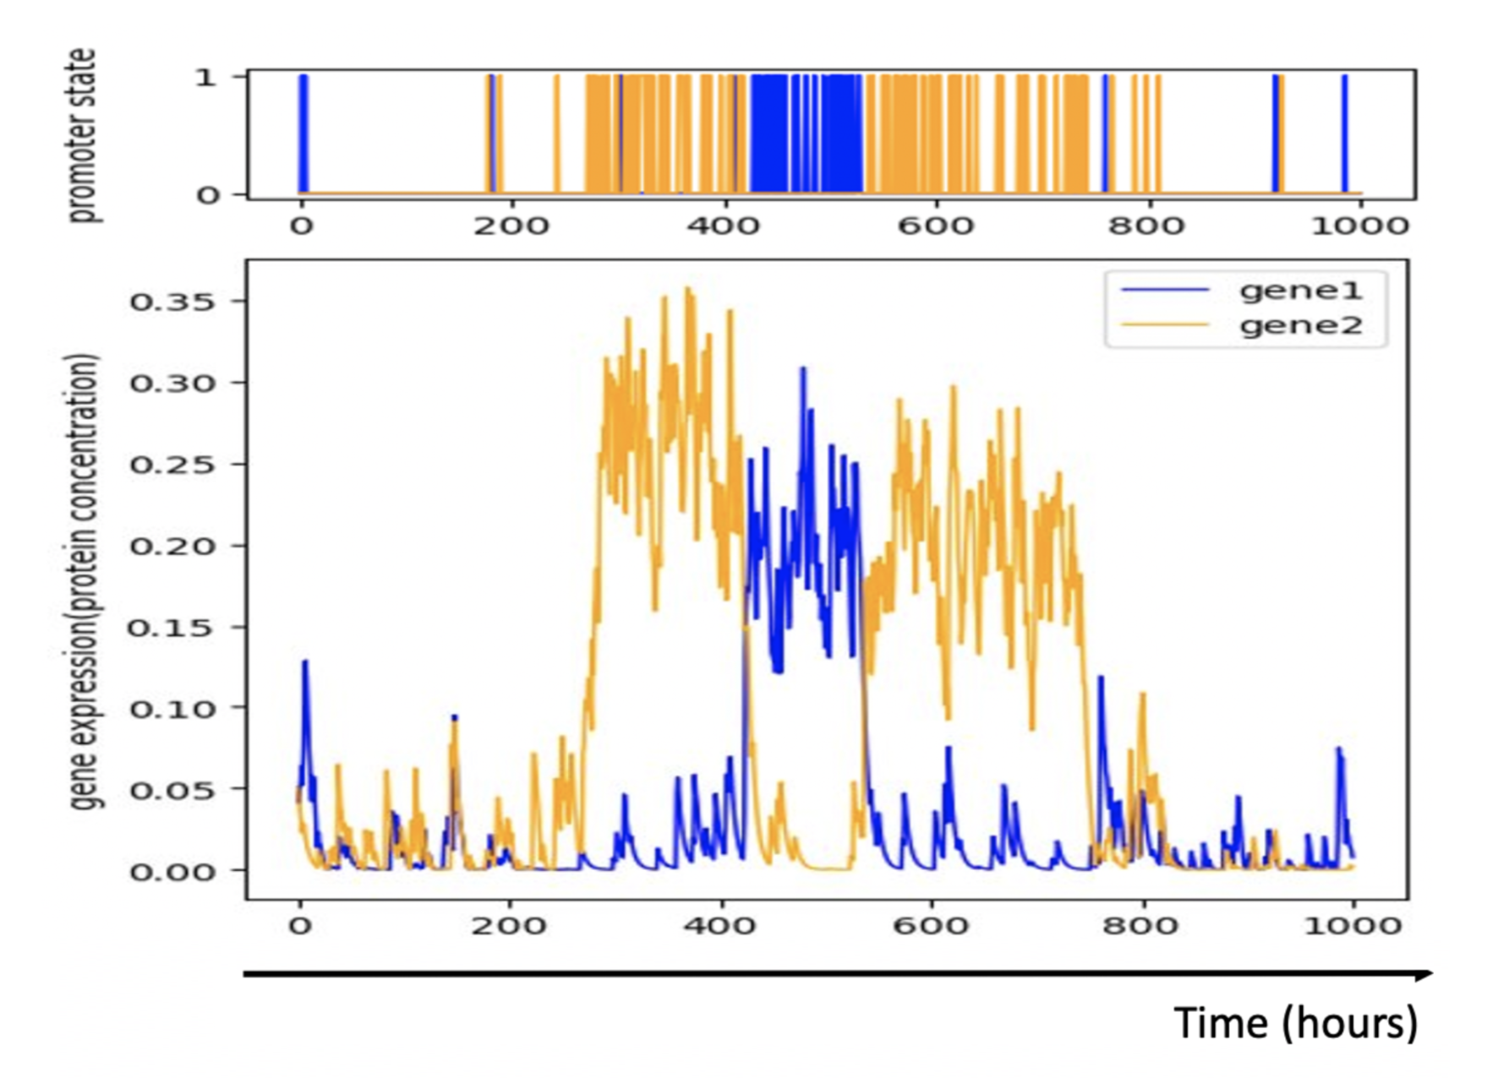
Each basin is characterized by a certain promoter firing frequency

Slide 24
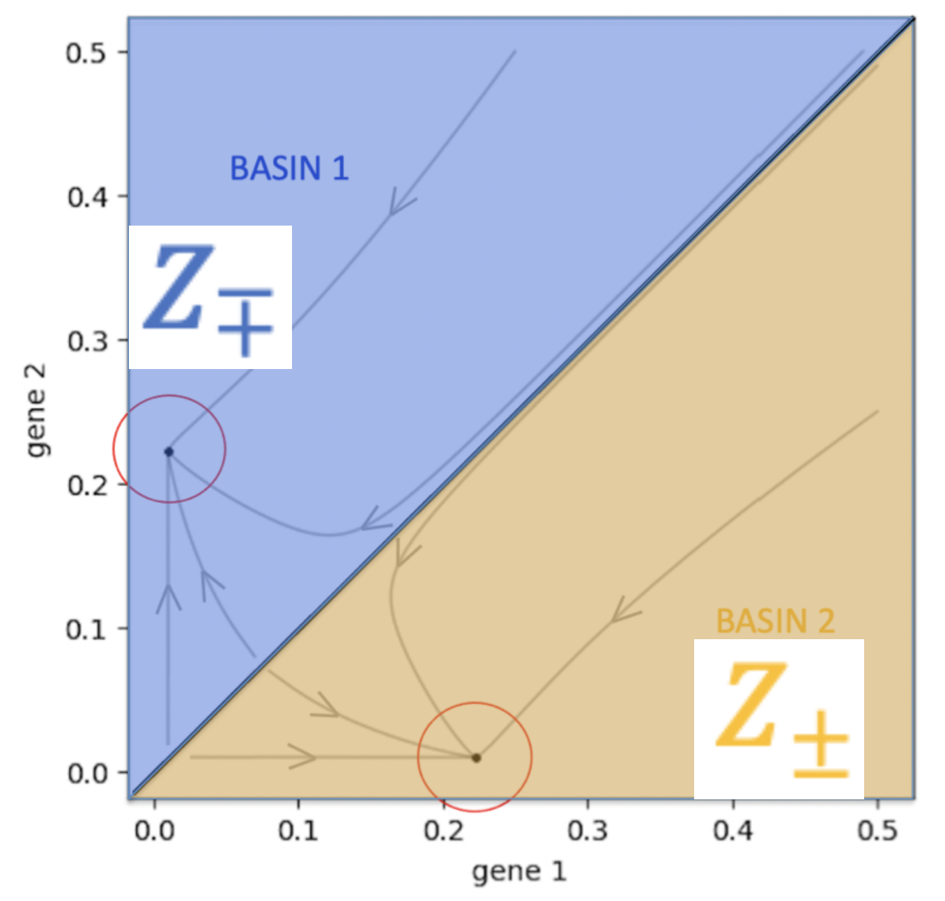
One can rewrite a simplified version of the model

Slide 25
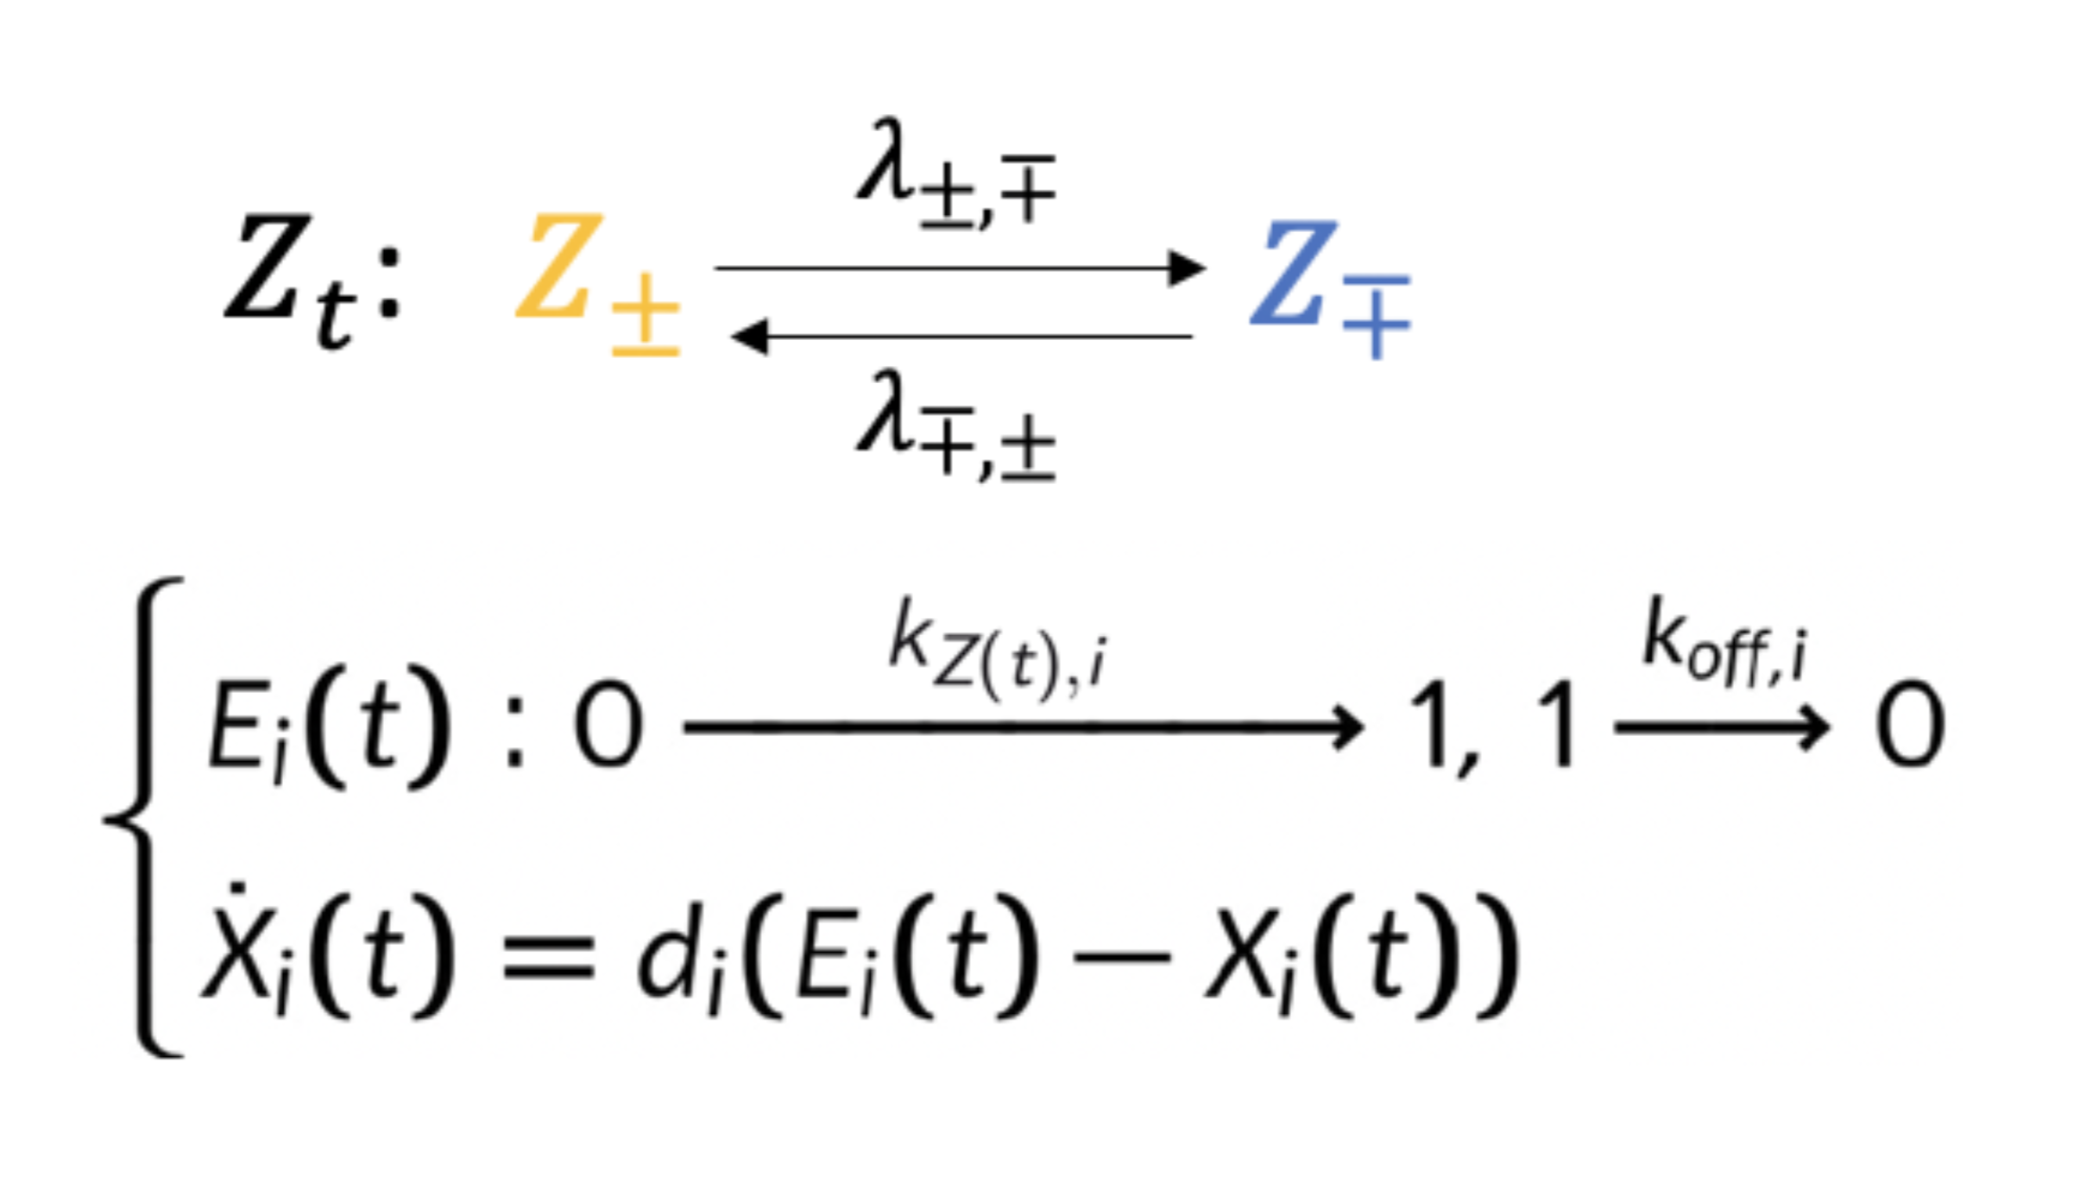
One can rewrite a simplified version of the model

Slide 26
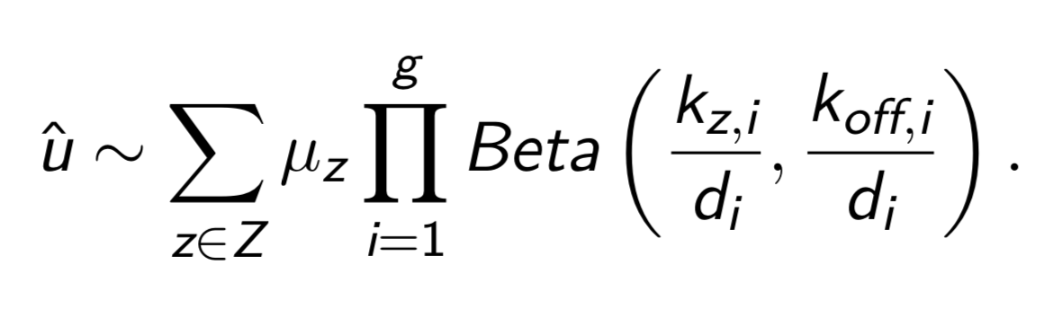
For which we found the stationary law
Ventre, E. (2021) . In Silico Biology, 14, pp. 89-113.

Slide 27
Benchmarking on in silico generated datasets

Slide 28
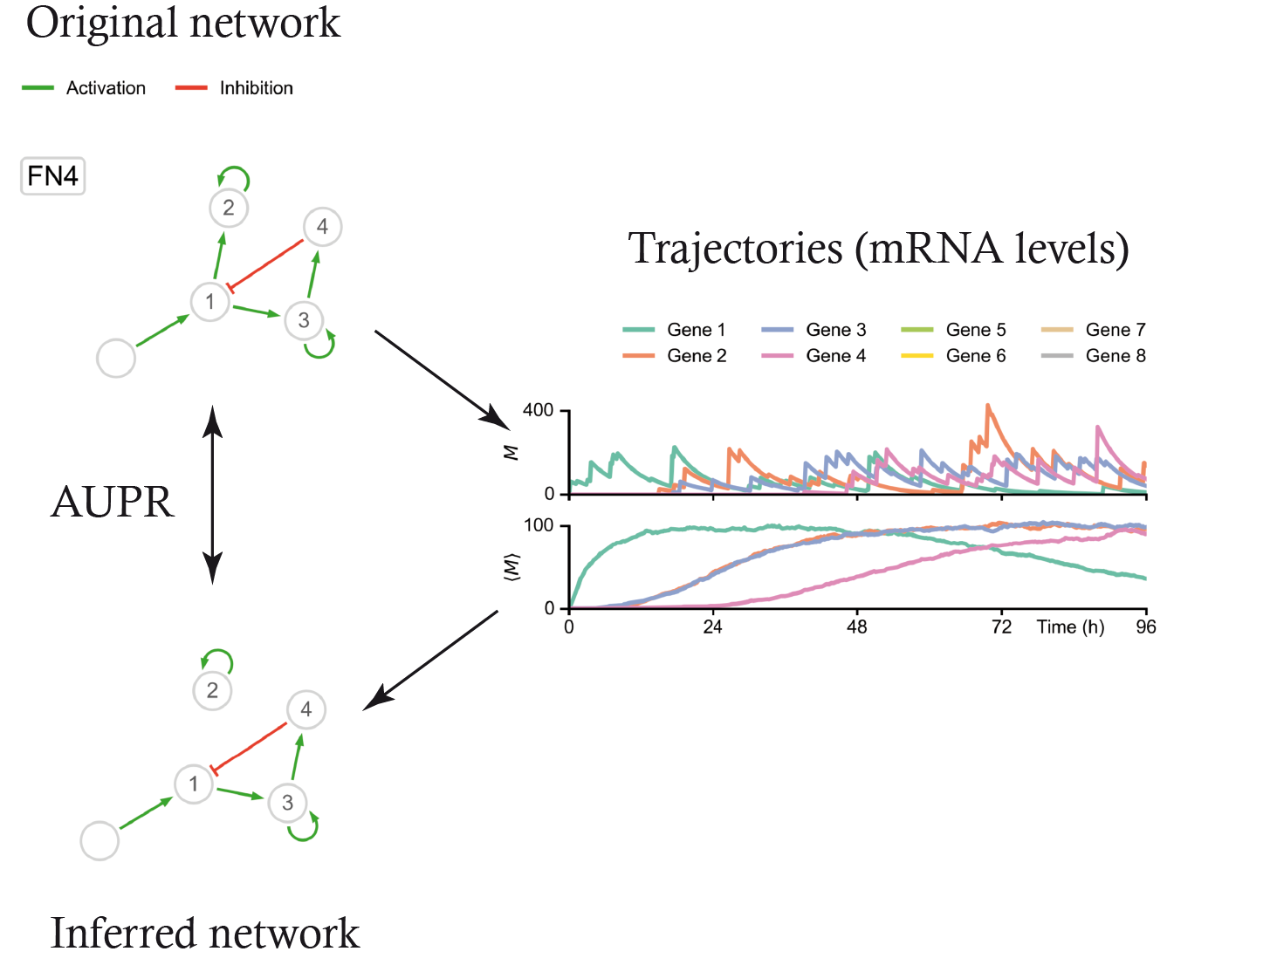

Slide 29
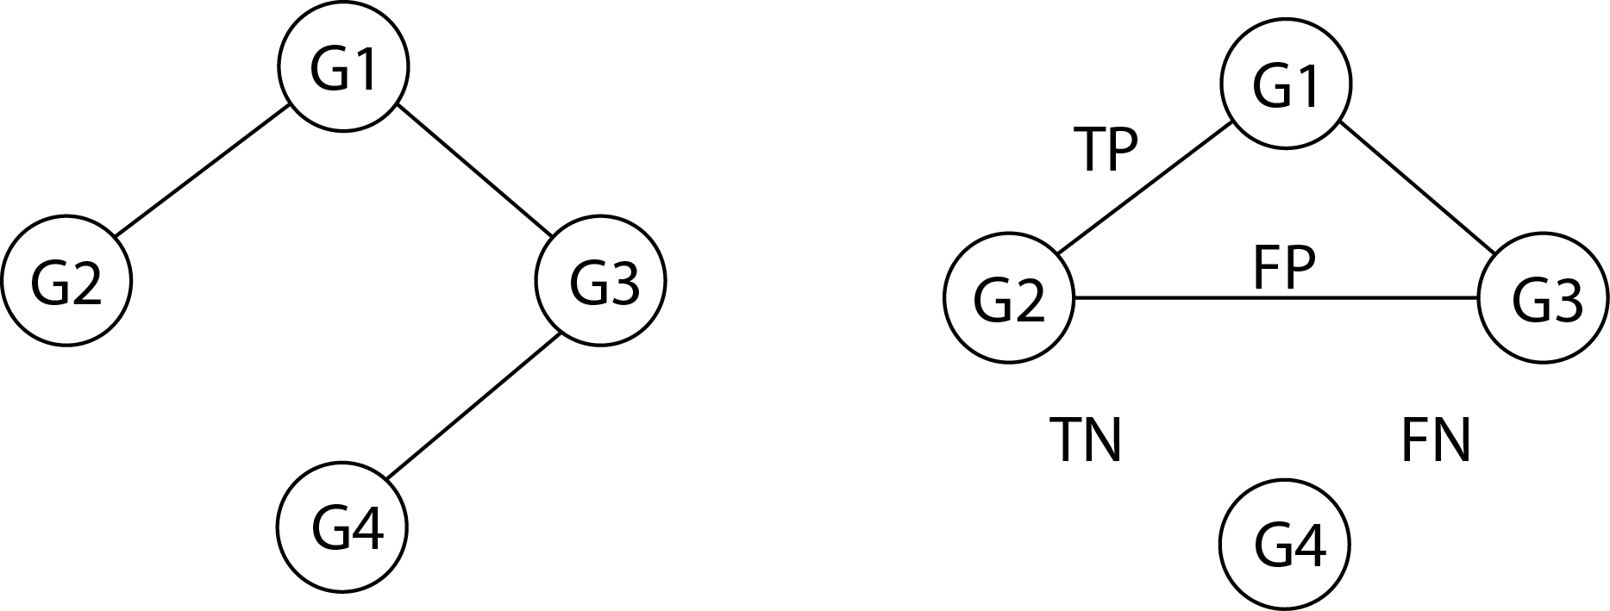
How to compare the inferred network from its original version? AUPR (area under the precision-recall curve)
True GRN Inferred GRN
Precision = TP / (TP + FP)
Recall = TP / (TP + FN)

Slide 30
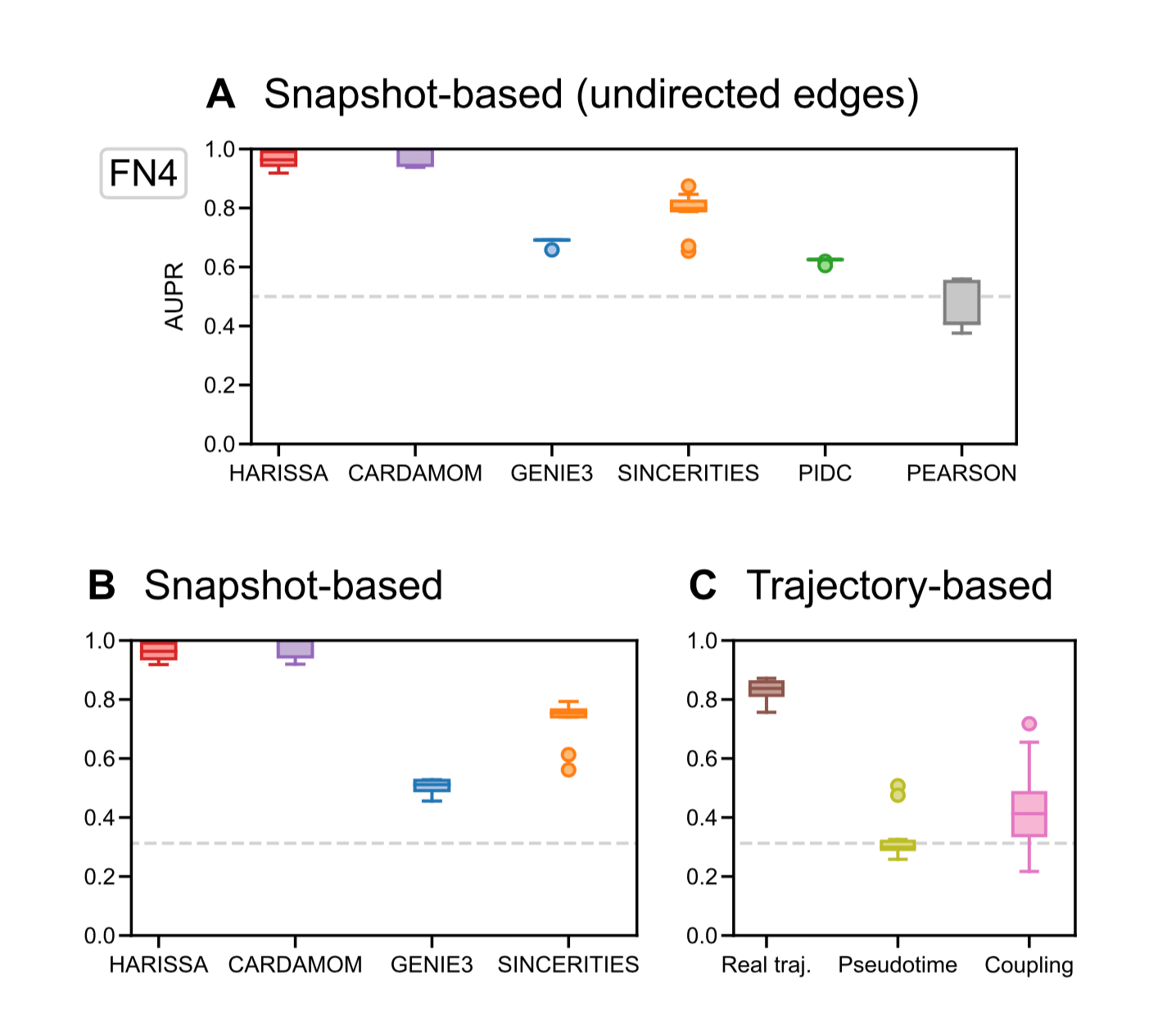
Notes:
Coupling: WOT C: algo SCRIBE. Pseudotime: SLINGSHOT

Slide 31
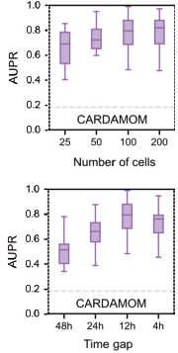

Slide 32
Applying to a real-life dataset

Slide 33
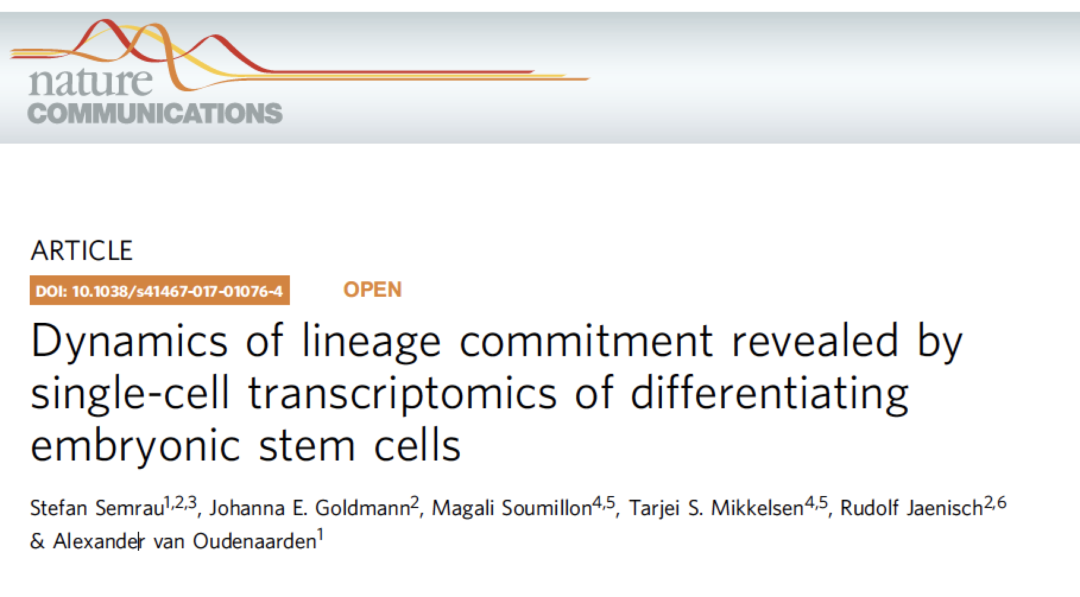

Slide 34
E14 mESCs were induced to differentiate by 0.25 mM ATRA addition.
Single cell RNAseq was performed using SCRB-seq: the result is a count table with a number of UMIs per gene per cell per time
All raw and processed data is freely available from the GEO repository.
We used the 41 genes that the authors have identified as being important for the process.

Slide 35
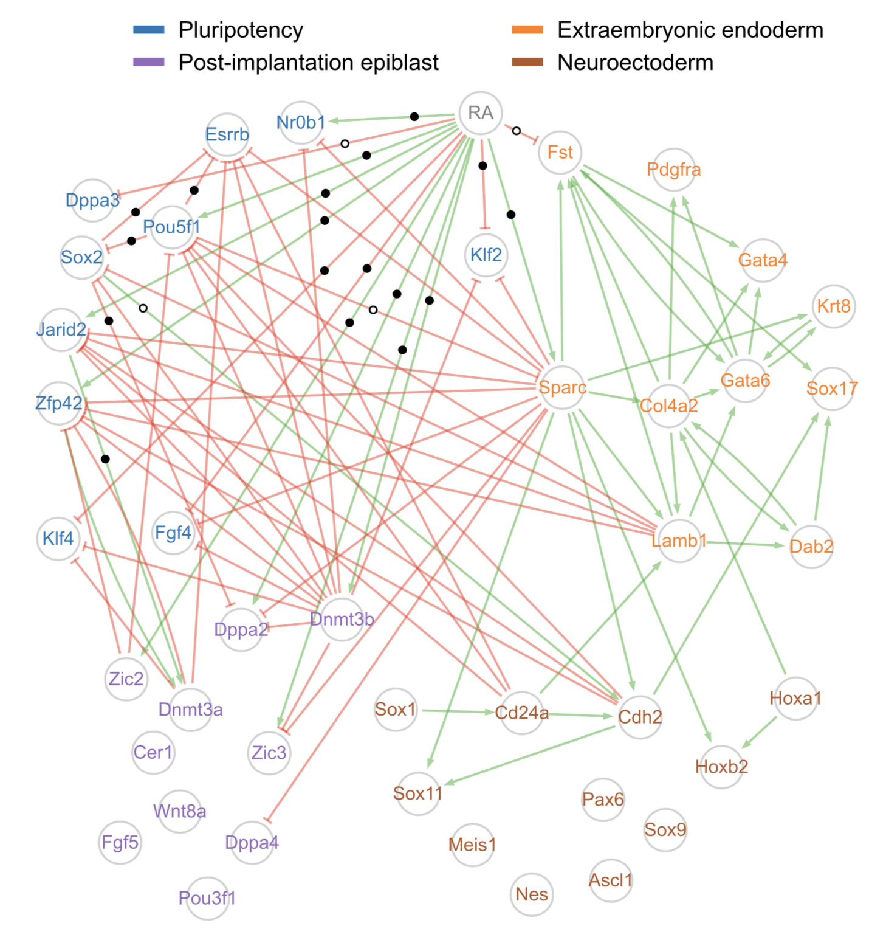

Slide 37
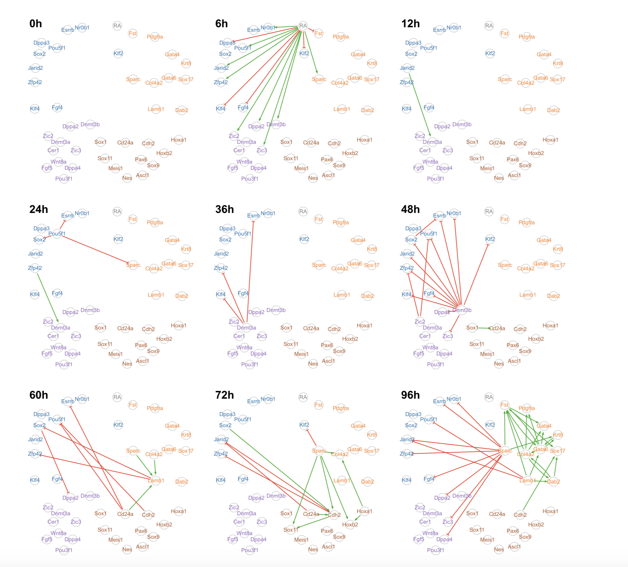
Bonus: Time decomposition of the GRN

Slide 38
How well are the experimental data reproduced?

Slide 39
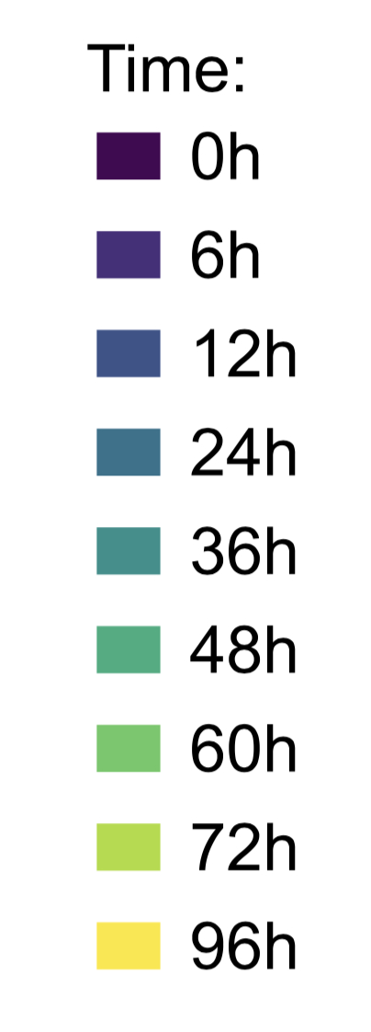
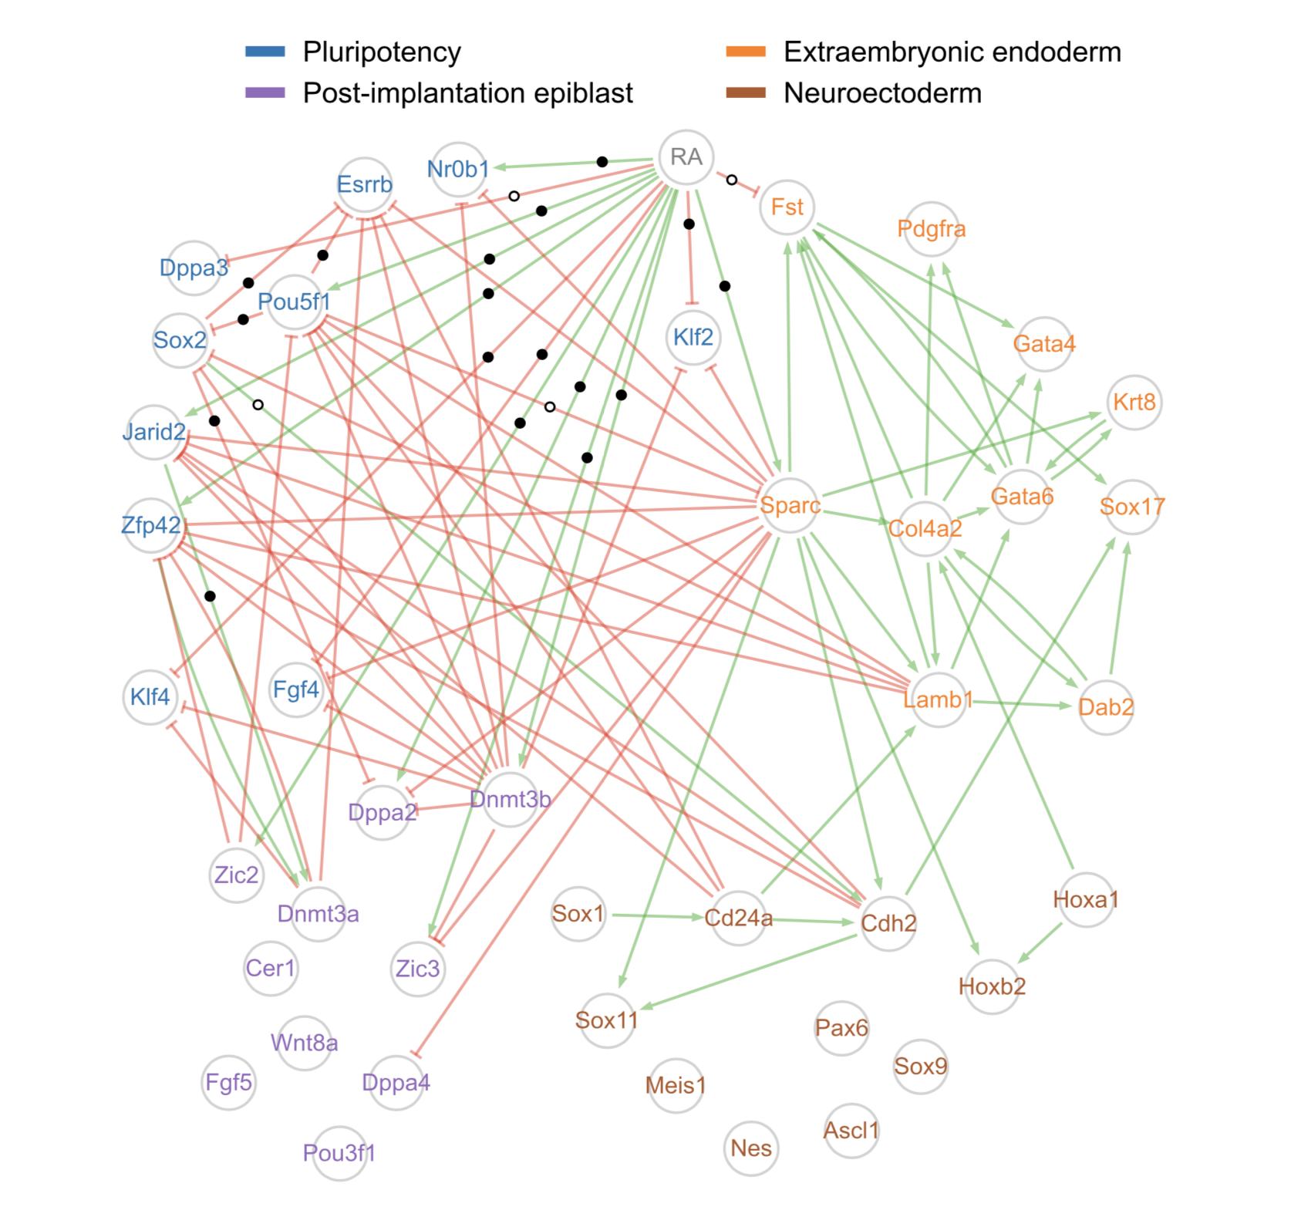

Slide 44
Conclusion
Far from being perfect but improves over previous works
There is enough information in the joint distributions to infer a reasonable GRN
Strong dependence on the simulation phase toward half-lives.
Requires time-stamped data, or some kind of « artificial time » when dealing with a single snapshot
Executable time-dependent predictions
Available: https://github.com/ogandril/cardamom
Long term: control

Slide 45



Special thank’s
Gérard Benoit (IGDR, Rennes)
Thibault Espinasse (ICJ, Lyon)
Ulysse Herbach (Inria, Nancy)
Elias Ventre (LBMC, Lyon)

